Slide 1
Diagnostics
Whenever data are obtained in a time sequence or some other type of sequence, such as for adjacent geographic areas, it is a good idea to prepare a plot of the residuals against time, called a sequence plot of the residuals.
The purpose of plotting the residuals against time or in some other type of sequence is to see if there is any correlation between error terms that are near each other in the sequence.
Consider an experiment to study the relationship between the diameter of a weld (X) and the shear strength of the weld (Y).

Slide 2
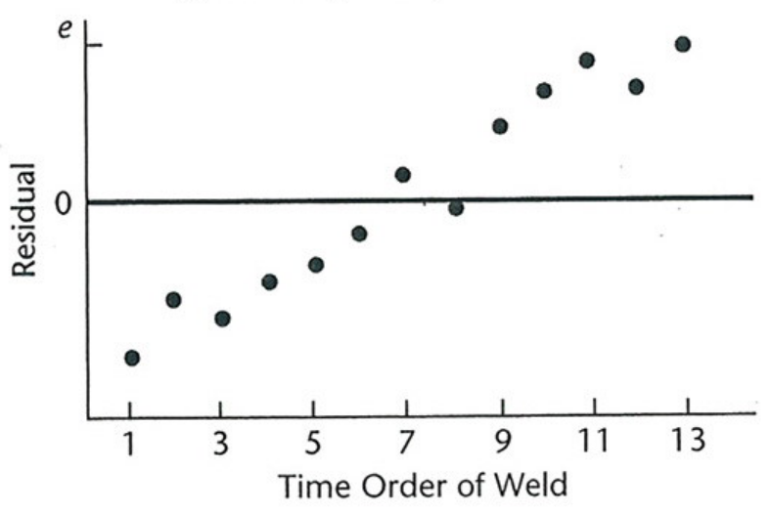
Diagnostics
The time sequence plot of the residuals indicates a correlation between the error terms.
Negative residuals occur at early trials and positive ones at later trials. Some effect connected with time was probably present, such as a learning effect of the welder, so that the shear strength (Y) tended to be greater in later welds.

Slide 3
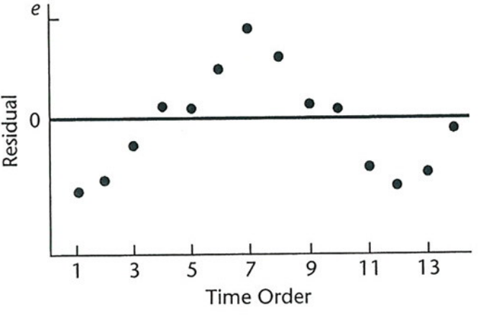
Diagnostics
It can be useful to view the problem of nonindependence of the error terms as the result of an important variable being omitted from the model (in this case time).
Another type of nonindependence is illustrated below. Here, it is clear that adjacent error terms are correlated; negative values tend to be close to negative values and positive values tend to be close to positive values.
When the error terms are independent, we expect a random scatter about 0.
(SAS – diagnostics_e)

Slide 4
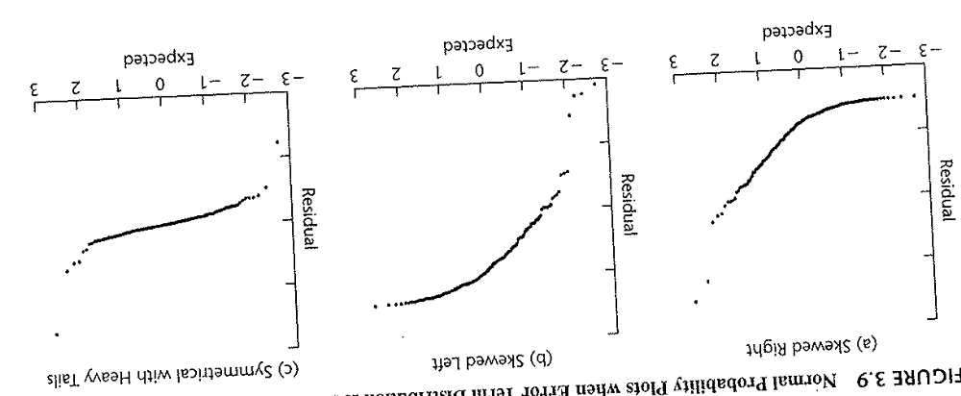
Diagnostics
To asses normality, we can create a normal probability plot of the residuals.
Normal probability plots plot observed values against their expected value under normality.
A plot that is nearly linear suggests agreement with normality while a plot that departs substantially from linearity suggests that the distribution of the error terms is not normal.

Slide 5
Diagnostics
It is more difficult to asses departures from normality than departures from the other assumptions.
Random variation can make it difficult to asses a probability distribution, unless the sample is very large.
Other types of departures also effect the distribution of the residuals. For example, if the error variance is not constant, the residuals may appear to not be normal.
It is usually a good strategy to check the other assumptions before checking the assumption of normality.

Slide 6
Diagnostics
Model misspecification due to either nonlinearity or the omission of an important variable tends to be serious, leading to biased estimates of the regression parameters and error variance.
Nonconstancy of error variance tends to be less serious, leading to less efficient estimates and invalid error variance estimates.
Outliers can be serious for smaller data sets when their influence is large.
Nonindependence of error terms results in estimators that are unbiased but whose variances are seriously biased.

Slide 7
Diagnostics
We will now go over some formal tests of the model assumptions but note even though graphical analysis is subjective, at times it can reveal difficulties with a model more clearly than formal tests.
To graphically test normality, we visually assess the approximate linearity of the points in a normal probability plot of the residuals.
A formal test can be conducted by calculating the coefficient of correlation between the residuals e_{i} and their expected values under normality.
A high value of this correlation coefficient is indicative of normality.

Slide 8
Diagnostics
Table B.6 in the appendix of our book contains critical values for various sample sizes for the distribution of the coefficient of correlation between the ordered residuals and their expected values under normality.
If the observed coefficient of correlation is at least as large as the tabled value, for a given α level, one can conclude that the error terms are reasonable normally distributed.
A formula for calculating the expected values of the residuals is given in the text.

Slide 9
Diagnostics
SAS provides four tests of normality in the proc univariate command.
The Shapiro-Wilk test is based approximately on the coefficient of correlation between the ordered residuals and their expected values under normality.
SAS also includes three goodness of fit tests: the Kolmonoz-Smirnov test, the Cramer-von Mises test, and the Anderson-Darling test.
The null hypothesis for these tests is that the assumption of normality is appropriate (normality holds).
If we reject the null, then we conclude that this assumption is violated. (SAS – diagnostics_e)

Slide 10
Diagnostics
The Brown-Forsythe (BF) test is a test for the constant variance assumption.
This test is robust against violations of the assumption of normality of the error terms.
As described, the BF test is applicable when the variance of the error terms either increases or decreases with X.
This is a result of the fact that we will break the values of X into two groups – large and small – and test if the two groups have the same variance.

Slide 11
Diagnostics
This test is based on the variability of the residuals. The larger the variance of the errors, the larger the variability of the residuals will tend to be.
To conduct the test, we divide the data into two groups, according to the values of X, so that one group consists of cases where the values of X are comparatively small and the other where they are comparatively large.
If the variance of the errors is either increasing or decreasing with X, the residuals in one group will tend to be more variable than those in the other group.
Equivalently, the absolute deviations of the residuals around their group mean will tend to be larger for one group than the other.

Slide 12
Diagnostics
In order to make the test more robust, we will use the absolute value of the deviations of the residuals from the group median instead of group mean.
The BF test then consists of the two-sample t test comparing the means of the absolute deviations of the two groups.
Let d_{j}(bar) be the mean of the absolute deviations from the median of the j^{th} group (j = 1,2). We are testing H_{o}: d₁(bar)= d₂(bar).
We will do an equivalent test in SAS, only we use the F statistic instead of t statistic, where again an F statistic is a t statistic squared.

Slide 13
Diagnostics
The distribution of the absolute deviations of the residuals is usually not normal.
However, it has been shown that the BF test statistic still follows approximately the normal distribution when the variance of the error terms is constant and the sample sizes of the two groups are not too small.
Let e_{ij} denote the i^{th} residual in the j^{th} group and e_{j}(tilda) denote the median of the j^{th} group
Also define n_{j} as the sample size of the j^{th} group.

Slide 14

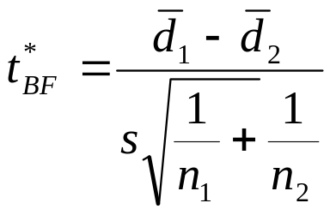
Diagnostics
The BF test uses the absolute deviations of the residuals around their group median, denoted by d_{ij} which is the i^{th} absolute deviation in the j^{th} group
The t statistic we use is

Slide 15
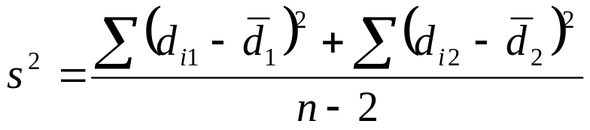
Diagnostics
We define s² as
If the error terms have constant variance and n₁ and n₂ are not very small, this t statistic follows approximately a t distribution with n-2 degrees of freedom.
For large absolute values of this t statistic, we reject the null that the means of the absolute deviations are the same.
Note this is a pooled t-test. That is, the variance is calculated as a pooled estimate.

Slide 16
Diagnostics
Rejecting the null that the means of the absolute deviations are the same indicates that the error terms do not have constant variance.
Note, our null, conceptually, is that the assumption of constant variance is true. If we fail to reject, then we are ok using this assumption.
Consider the Toluca example. Since the X levels are spread fairly uniformly, we divide the 25 cases into two groups with approximately equal X ranges.
The first group consists of the 13 runs with lot sizes from 20 to 70 (group 1). The second group consists of the 12 runs with lot sizes from 80 to 120 (group 2).

Slide 17
Diagnostics
The median of the residuals for group 1 is -19.88 and the median of the residuals for group 2 is -2.68.
Once we have the median residual for each group, we calculate the deviations of each residual from its group median, and take the absolute value.
So for the first residual in group 1 , which equals – 48.472, we have that
Once we have the absolute deviations for each group, we can proceed with doing a t test, testing the null that the means of the absolute deviations are the same. SAS: BF test

